Slide 1
INB/N371 Data Structures and Algorithms
LECTURE 5
List ADT
(Acknowledgement: some slides are adapted from lecture slides by
Nyhoff, ADTs, Data Structures and Problem Solving with C++)
Dr. Yue Xu
Faculty of Science and Technology
Queensland University of Technology

Slide 2
This Week
List as an ADT
List ADT implementation
Static array based implementation
Linked list based implementation
Reference: Chapter 6, Nyhoff textbook
2

Slide 3
Lists
Consider every day lists
Groceries to be purchased
Job to-do list
List of assignments for a course
….
A list is a linear data structure that is used to store a series of items.
3

Slide 4
Properties of Lists
Can have a single element
Can have no elements
There can be lists of lists
The order that the items appear in a list is significant.
e.g. [a, b, c, d] ≠ [a, c, b, d]
4

Slide 5
List as an ADT
We will look at the list as an abstract data type representing a series of
Homogeneous, finite length, sequential elements of any type
Possible operations
Construct lists
Determine whether or not a list is empty
Insert an element into the list
Delete an element from the list
Traverse (iterate through) the list in order to perform operations such as:
display, modify, search for a specific value, copy, save, or rearrange
……..
5

Slide 6
List as an ADT
Should contain at least the following function members
Constructors : create lists
empty(): check if list is empty
insert(): insert an item
erase() : remove an item
display(): output the list
6

Slide 7
List Specification
//List.h, header file of the List ADT
#include<iostream>
typedef int ElementType;
class List
{public:
/* Pre: true
* Post: construct an empty list
*/
List();
/* Pre: true
* Post: return true if the list is empty;
* otherwise, return false.
*/
bool empty() const;
. . . . . .
};
typedef double ElementType;
typedef anExistingType ElementType;
7

Slide 8
List Specification
//List.h, header file of the List ADT
#include<iostream>
typedef int ElementType;
class List
{ . . . . . .
/* Pre: 0 <= pos <= mySize < CAPACITY
* Post: Object item is added to the list at the specified
* position pos, mySize increases by one
*/
void insert(ElementType item, int pos);
/* Pre: 0 <= pos < mySize
* Post: the item at the specified position is removed
* from the list, mySize decreases by one
*/
void erase(int pos);
. . . . . .
};
8

Slide 9
List Specification
//List.h, header file of the List ADT
#include<iostream>
typedef int ElementType;
class List
{ . . . . . .
/* Pre: out is an ostream object
* Post: List’s contents have been output to out
*/
void display(ostream & out) const;
. . . . . .
};
9

Slide 10
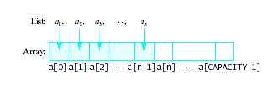
Array-based Implementation
An array is a viable choice for storing list elements
It is a commonly available data type
Algorithm development is easy
Element are sequential. Normally sequential orderings of list elements match with array elements
10
10
Notes:
10

Slide 11
Array-based Implementation
//List.h, header file of the List ADT
#include<iostream>
const int CAPACITY=1024;
typedef int ElementType;
class List
{ public:
. . . . . .
private:
int mySize; //current size of list
ElementType myArray[ ]; //array to store the list
};
CAPACITY
?
Semester 1, 2009
INB/N371 Data Structures and Algorithms
11
11
11
11
Notes:
11

Slide 12
Array-based Implementation –List(),empty()
Constructor - Initialize variables in the class
Empty - Check if size == 0
List::List( )
: mySize(0)
{ }
bool List::empty() const
{
return mySize == 0;
}
12

Slide 13
Array-based Implementation - display()
//--- Definition of display()
void List::display(ostream & out) const
{
for (int i = 0; i < mySize; i++)
out << myArray[i] << " ";
}
In a client program, assume: myList is an object of List with elements [10,20,30] , then:
myList.display(cout) will display: 10 20 30
Can we display the list by: cout << myList ?
Yes, we can, we just need to overload the operator <<
13

Slide 14
Overloading Operators - operator<<
cout << myList;
Define a function with operator∆ as the function name, the operands with their types as the function parameters, i.e., operator∆(type a, type b)
operand
type a
operator
∆
operand
type b
ostream & operator<<(ostream & out, const List & aList)
{
aList.display(out);
return out;
}
14

Slide 15


Array-based Implementation
Insert
Shift elements to right of insertion point
Delete
Shift elements back
0 1 2 3 4 5 ……
Insert 56 at position 4
Also adjust size up or down
0 1 2 3 4 5 ……
Remove 25 from position 1
15

Slide 16
Array-based Implementation - inset()
//--- Definition of insert()
void List::insert(ElementType item, int pos)
{
if (mySize == CAPACITY)
{
cerr << “No space for list element -- terminating "
"execution ***\n";
exit(1);
}
if (pos < 0 || pos > mySize)
{
cerr << "*** Illegal location to insert -- " << pos
<< ". List unchanged. ***\n";
return;
}
………….
16

Slide 17
Array-based Implementation - inset()
………….
// First shift array elements right to make room for item
for(int i = mySize; i > pos; i--)
myArray[i] = myArray[i - 1];
// Now insert item at position pos and increase list size
myArray[pos] = item;
mySize++; //increase list size
}
pos
mySize
insert(56, 4)
i
0 1 2 3 4 mySize -1
pos
0 1 2 3 4
17

Slide 18
Array-based Implementation - erase()
// Definition of erase()
void List::erase(int pos)
{
if (mySize == 0)
{
cerr << "*** List is empty ***\n";
return;
}
if (pos < 0 || pos >= mySize)
{
cerr << "Illegal location to delete -- " << pos
<< ". List unchanged. ***\n";
return;
}
// Shift array elements left to close the gap
for(int i = pos; i < mySize; i++)
myArray[i] = myArray[i + 1];
// Decrease list size
mySize--; }
erase(1)
pos
i
0 1 2 3 4 mySize
18

Slide 19
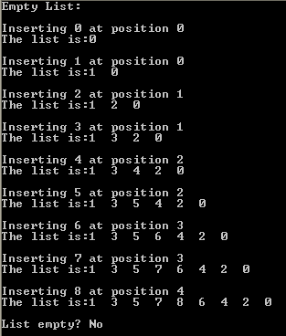
Array-based Implementation
Client program: TestList.cpp
int main()
{ List intList;// Test the class constructor
if (intList.empty())
cout << "Empty List: \n"<< intList << endl;
for (int i = 0; i < 9; i++) // Test insert()
{
cout << "Inserting " << i << " at position "
<< i/2 << endl;
intList.insert(i, i/2); // -- Insert i at position i/2
cout << "The list is:" << intList << endl<<endl;
}
cout << "List empty? "
<< (intList.empty() ? "Yes" : "No") << endl;
. . . . .
19

Slide 20
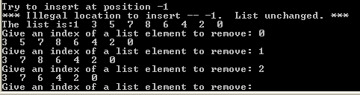
Array-based Implementation
. . . . .
cout << "\nTry to insert at position -1" << endl;
intList.insert(0, -1);
cout << "The list is:" << intList << endl;
int index;// Test erase
while (!intList.empty())
{cout << "Give an index of a list element to remove: ";
cin >> index;
intList.erase(index);
cout << intList << endl;
}
cout << "List empty? "
<< (intList.empty() ? "Yes" : "No") << endl;
return 0;
}
20

Slide 21
Problems with Array Implementation
Stuck with "one size fits all"
Could be wasting space
Could run out of space
All elements are allocated in consecutive locations.
One solution:
Remove the requirement that list elements be stored in consecutive location.
But then need a "link" that connects each element to its successor
Linked Lists !!

Slide 22

Linked List
A linked list is a collection of nodes. Each node contains:
Data part – stores an element of the list
Next part – stores link/pointer to next element (when no next element, null value)

Slide 23
Definition of Nodes
To Implement Nodes
class Node { public:
int data;
Node * next; };
Note: The definition of a Node is self-referential
It uses the name Node in its definition
The next member is defined as a pointer to a Node

Slide 24
Definition of Nodes
Node constructor for creating Node objects
class Node { public:
int data;
Node * next;
//--- Node constructor
Node(ElementType value, Node * link = 0)
{ data = value; next = link; }
};

Slide 25
Working with Nodes
Declaring pointers Node * ptr; or
typedef Node * NodePointer; NodePointer ptr;
Allocate and deallocate ptr = new Node; delete ptr;
Access the data and next part of node (*ptr).data and (*ptr).next
or ptr->data and ptr->next

Slide 26
Linked List
A linked list is a collection of self-referential nodes linked linearly by the “Next” members.
Linked list is dynamic – the nodes are created dynamically and the size of a linked list changes dynamically.
Usually a pointer variable is used to point to the first node in a linked list.

Slide 27
List Specification
//LList.h, header file of List ADT
typedef int ElementType; class List { private: class Node { public: ElementType data; Node * next;
//--- Node constructor
Node(ElementType value, Node * link = 0)
{ data = value; next = link; }
};
typedef Node * NodePointer;
. . . . . .

Slide 28
List Specification
. . . . .
public: //List functions
List();//constructors
List(const List & original);//deep copy constructor
~List();//destructor
List & operator=(const List & original);//assignment
bool empty() const; //empty operation
void insert(ElementType item, int pos);//insert operation
void erase(int pos); //erase operation
void display(ostream & out) const;//output operation
private: //List Data Members
int mySize; // number of nodes currently in the list
NodePointer first; //points to first node
}; //--- end of List class

Slide 29

Implementing List Operations(Linked list)
Default constructor
List::List() //default
{
first = 0;
mySize =0;
}
List * myList = new List();
List myList;
myList
myList

Slide 30
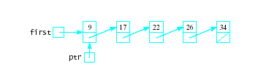
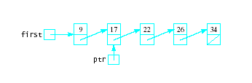
Traverse Linked Lists
Initialize a variable ptr to point to first node
Process data where ptr points: ptr->data
Move to next node : ptr = ptr->next
Continue until ptr == 0

Slide 31
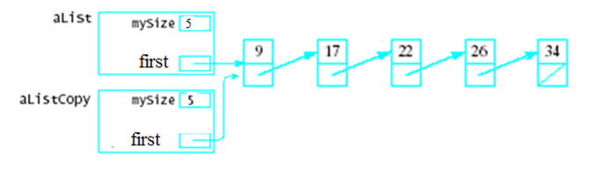
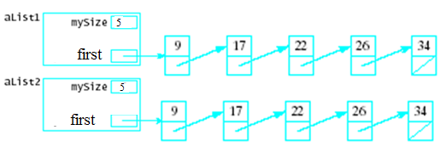
Implementing List Operations(Linked list)
Shallow copy or member-wise copy will copy data members
one by one from one object to another.
aListCopy = aList;
Copy Constructor – makes a "deep copy" of an object
List(const List & origList)
Parameter must be a reference to the object to be copied
Better be const to protect the original argument from being modified.
e.g. aList1 is an existing object of List
List aList2(aList1);

Slide 32



Implementing List Operations(Linked list)
Copy constructor
origPtr
origPtr
List:: List(const List & original)
{
if (!original.empty())
{
// Copy first node
first = new List::Node(original.first->data);
// Set pointers to run through the linked list
List::NodePointer lastPtr = first,
origPtr = original.first->next;
while (origPtr != 0)
{
lastPtr->next = new List::Node(origPtr->data);
lastPtr = lastPtr->next;
origPtr = origPtr->next;
}
mySize = original.mySize;
}
}
lastPtr
lastPtr

Slide 33

Implementing List Operations(Linked list)
Destructors
When class object becomes not in use the pointer to the dynamically allocated memory is reclaimed automatically
Other dynamically allocated memory is not
The destructor is to reclaim dynamically allocated memory
aList1

Slide 34

Implementing List Operations(Linked list)
Destructor
List::~List()
{
// Set pointers to run through the List
List::NodePointer currPtr = first, // node to be deallocated
nextPtr; // its successor
while (currPtr != 0)
{
nextPtr = currPtr->next;
delete currPtr;
currPtr = nextPtr;
}
cout <<"destructor \n";
}
currPtr
currPtr
nextPtr
nextPtr

Slide 35
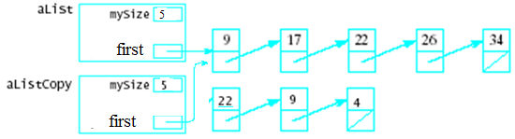
Implementing List Operations(Linked list)
Assignment operator
Default assignment operator makes shallow copy
Can cause memory leak, dynamically-allocated memory has nothing pointing to it
Tutorial work
aListCopy = aList;

Slide 36
List Implementation with Dynamic Array
If a class allocates memory at run time using the new, then it should provide …
A destructor
A copy constructor
An assignment operator

Slide 37
Implementing List Operations(Linked list)
insert(20, 2);
Insertion
first
9
17
22
26
Step 1: find the insertion node ptr and its predecessor pre,
ptr gives the position to insert the new node;
ptr
pre
pre
ptr
ptr
first
9
17
22
26
i = 0
i = 1
i = 2
List::NodePointer ptr = first;
List::NodePointer prev = 0;
for(int i = 0; i < pos; i++)
{
prev = ptr;
ptr = ptr->next;
}
List::NodePointer aNode = new List::Node(item);
prev->next = aNode;
aNode->next = ptr;

Slide 38
Implementing List Operations(Linked list)
insert(20, 2);
Insertion
first
9
17
22
26
Step 1: find the insertion node ptr and its predecessor pre,
ptr gives the position to insert the new node;
pre
ptr
first
9
17
22
26
i = 2
Step 2: create a new node for item 20
List::NodePointer ptr = first;
List::NodePointer prev = 0;
for(int i = 0; i < pos; i++)
{
prev = ptr;
ptr = ptr->next;
}
List::NodePointer aNode = new List::Node(item);
prev->next = aNode;
aNode->next = ptr;
aNode
20
38

Slide 39
Implementing List Operations(Linked list)
insert(20, 2);
Insertion
Step 3: insert the new node in between pre and ptr.
prev->next = aNode;
aNode
20
aNode->next = ptr;
pre
ptr
first
9
17
22
26
List::NodePointer ptr = first;
List::NodePointer prev = 0;
for(int i = 0; i < pos; i++)
{
prev = ptr;
ptr = ptr->next;
}
List::NodePointer aNode = new List::Node(item);
prev->next = aNode;
aNode->next = ptr;
Step 4: mySize ++ ;
39

Slide 40
Implementing List Operations(Linked list)
insert(7, 0);
Insertion
first
9
17
22
26
Step 1: create a new node for item 7;
aNode
7
Step 2: insert the new node.
aNode
7
Step 2.2
aNode.next = first;
first = aNode;
first
9
17
22
26
Step 3: mySize ++
List::NodePointer aNode = new List::Node(item);
aNode->next = first;
first = aNode;
40

Slide 41
Implementing List Operations(Linked list)
void List::insert(ElementType item, int pos)
{// check the pre-conditions
if((pos >= 0)&&(pos <= mySize))
{
if(pos == 0) //special case: insert at front
{ List::NodePointer aNode = new List::Node(item);
aNode->next = first;
first = aNode;}
else //general case
{ List::NodePointer ptr = first;
List::NodePointer prev = 0;
for(int i = 0; i < pos; i++)
{ prev = ptr;
ptr = ptr->next;}
List::NodePointer aNode = new List::Node(item);
prev->next = aNode;
aNode->next = ptr;
}
mySize++;
}}
Insertion
41

Slide 42
Implementing List Operations(Linked list)
Check empty
Display
//--- Definition of empty()
bool List::empty() const
{
return (first == 0);
}
void List::display(ostream & out) const
{
List::NodePointer ptr = first;
while(ptr !=0)
{
out << ptr->data << " ";
ptr = ptr->next;
}
}
42

Slide 43

Implementing List Operations(Linked list)
predptr
ptr
Tutorial work
To free space
Deletion
Delete node containing 22 from list.
Suppose ptr points to the node to be deleted
predptr points to its predecessor (the 17)
Do a bypass operation:
Set the next pointer in the predecessor to point to the successor of the node to be deleted
Deallocate the node being deleted.
preptr->next = ptr->next;
delete ptr;

Slide 44
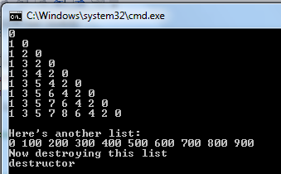
Implementing List Operations(Linked list)
Client program: TestLList
int main()
{ List intList;
if (intList.empty()) // Test empty()
cout << "Empty List: \n“ << intList << endl;
for (int i = 0; i < 9; i++) // Test insert()
{ intList.insert(i, i/2);//Insert i at position i/2
cout << intList << endl;
}
// Test destructor
{ List anotherList;
for (int i = 0; i < 10; i++)
anotherList.insert(100*i, i);
cout << "\nHere's another list:\n" << anotherList << endl;
cout << "Now destroying this list\n";
} . . . . .

Slide 45
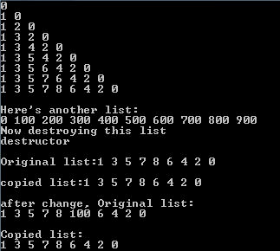
Implementing List Operations(Linked list)
// Test the copy constructor
List cList(intList);
cout << "\nOriginal list:";// Output the original to make
cout << intList<< endl; // sure it hasn't been changed
cout << "\ncopied list:"; // Output the original to make
cout << cList<< endl; // sure it hasn't been changed
intList.insert(100,5);//change original list
cout << "\nafter change, Original list:\n";
cout << intList<< endl; // sure it hasn't been changed
cout << "\nCopied list:\n"; // Output the original to make
cout << cList<< endl; // sure it hasn't been changed
. . . . .
Client program: TestLList

Slide 46
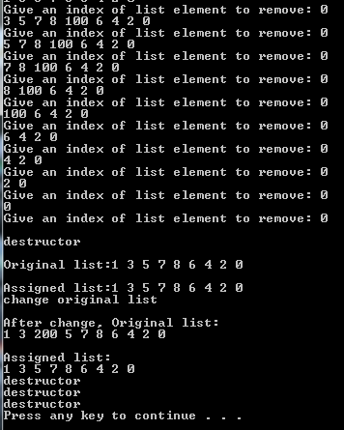
Implementing List Operations(Linked list)
int index;// Test erase
while (!intList.empty())
{ cout << "Give an index of list element to remove: ";
cin >> index;
intList.erase(index);
cout << intList << endl;
}
List eList; //Test operator =
eList = cList;
cout << "\nOriginal list:"; // Output the original to make
cout << cList<< endl; // sure it hasn't been changed
cout << "\nAssigned list:"; // Output the original to make
cout << eList<< endl; // sure it hasn't been changed
cout <<"change original list \n";
cList.insert(200,2); //change original cList
cout << "\nAfter change Original list, Original list:\n“;
cout << cList<< endl; //it has been changed
cout << "\nAssigned list: \n"; // Output the assigned list
cout << eList<< endl; // it hasn't been changed
}
Client program: TestLList

Slide 47
Linked Lists
Advantages
Access any item as long as external link to first item maintained
Insert new item without shifting
Delete existing item without shifting
Can expand/contract as necessary
Disadvantages
No longer have direct access to each element of the list
Access of n^{th} item now less efficient -- must go through first element, and then second, and then third, etc.

Slide 48
Do List
Review Lecture 5
Study Nyhoff
Exercises 6.4, questions 1– 3, Exercises 6.5, questions 1-7
Do tutorial 5
Semester 1, 2008
48

